Slide 1
Modelling Waterslide Descent Time

Slide 2
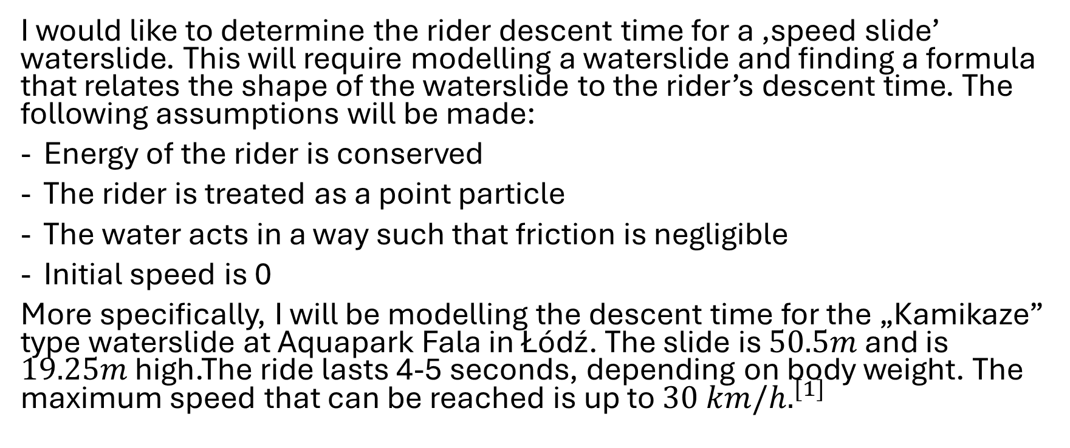
Research Question and Hypothesis
I would like to determine the rider descent time for a ‚speed slide’ waterslide. This will require modelling a waterslide and finding a formula that relates the shape of the waterslide to the rider’s descent time. The following assumptions will be made:
Energy of the rider is conserved
The rider is treated as a point particle
The water acts in a way such that friction is negligible
Initial speed is 0
More specifically, I will be modelling the descent time for the „Kamikaze” type waterslide at Aquapark Fala in Łódź. The slide is $50.5m$ and is $19.25m$ high.The ride lasts 4-5 seconds, depending on body weight. The maximum speed that can be reached is up to $30 km/h.^{[1]}$

Slide 3
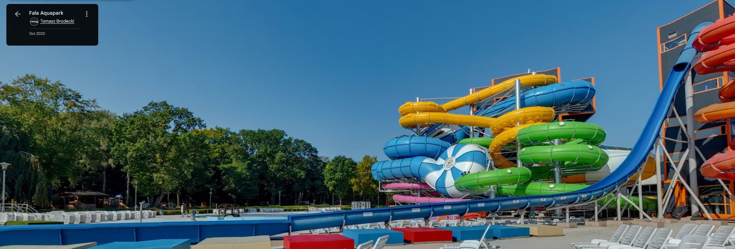
Hypothesis
The descent time of a rider on a waterslide can be modelled as a function of the slide’s gradient, length, and height.

Slide 4
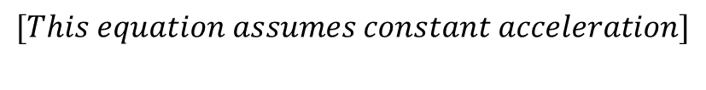
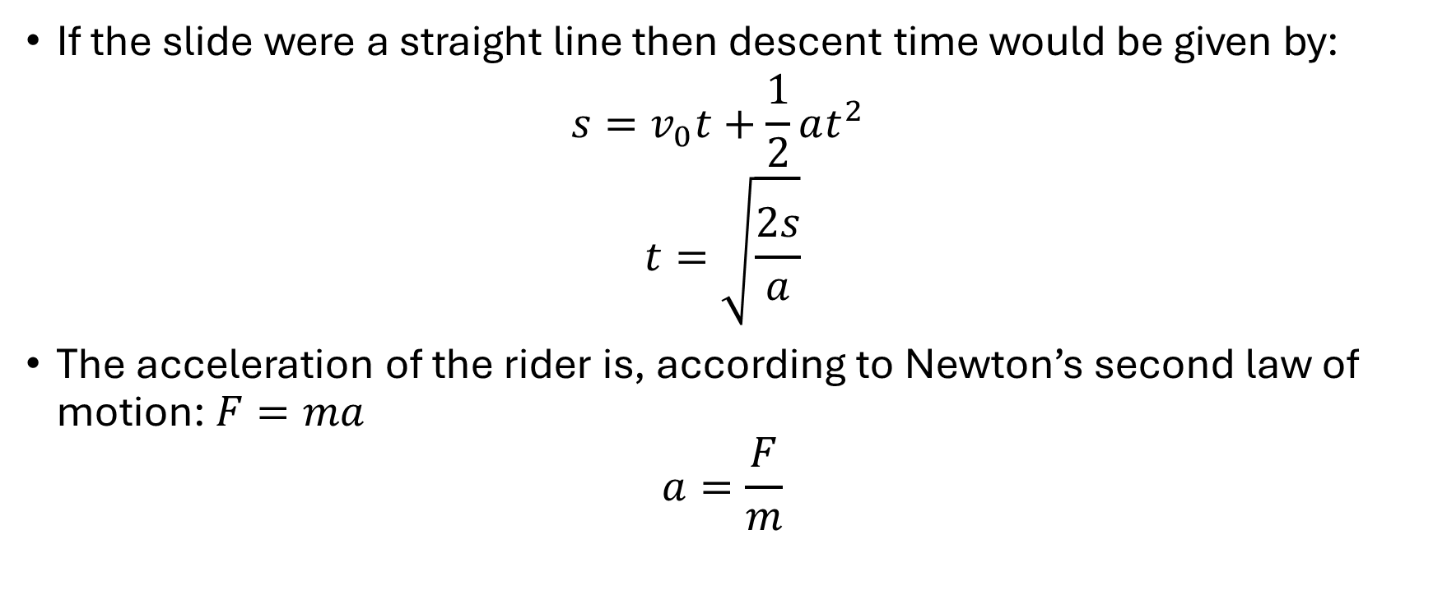
Finding a formula to determine descent time
If the slide were a straight line then descent time would be given by:
$$s=v_{0}t+\frac{1}{2}at^{2}$$
$$t=\sqrt{\frac{2s}{a}}$$
The acceleration of the rider is, according to Newton’s second law of motion: $F=ma$
$$a=\frac{F}{m}$$
$$[This equation assumes constant acceleration]$$

Slide 5
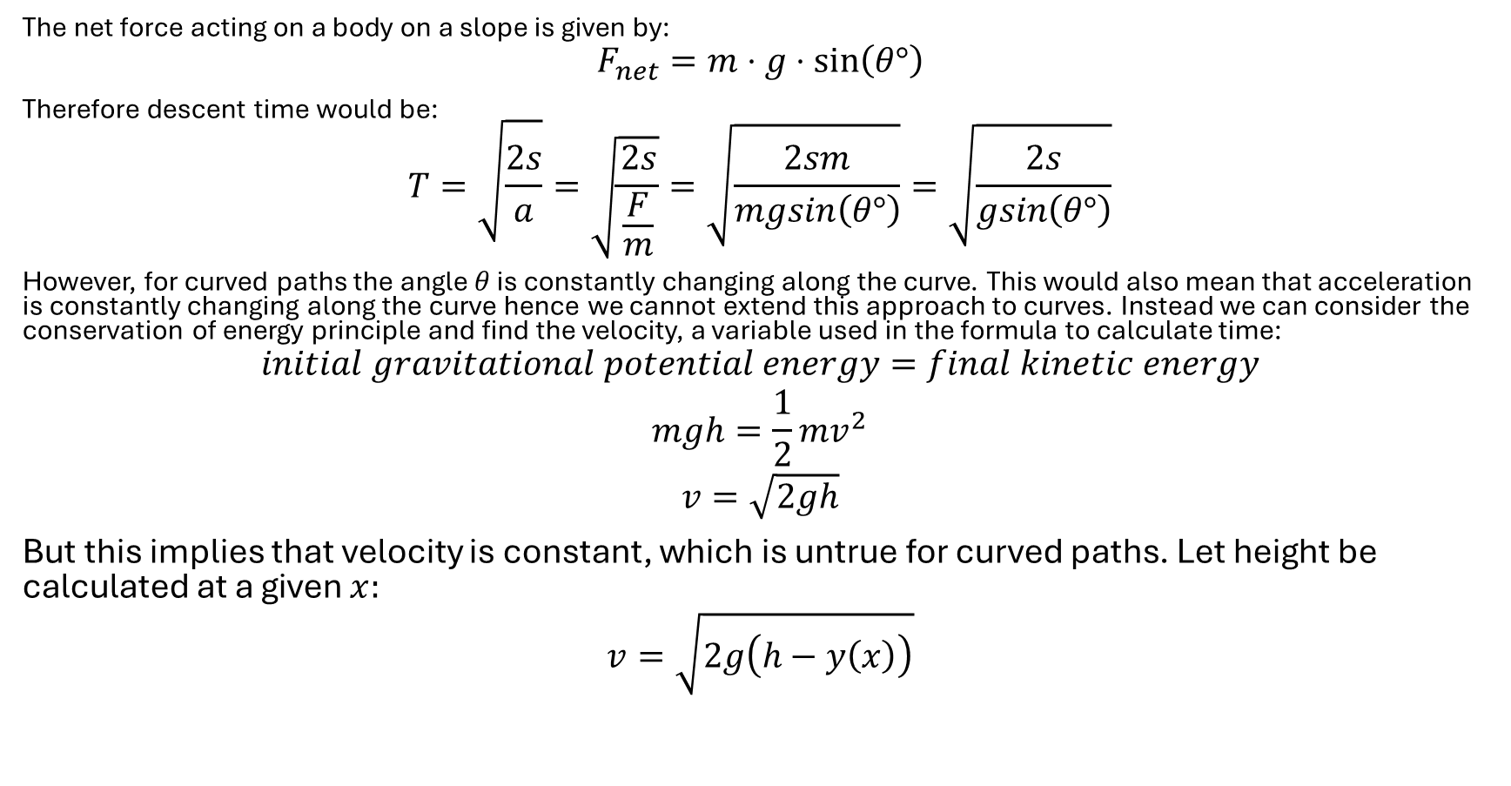
Finding a formula to determine descent time
The net force acting on a body on a slope is given by:
$$F_{net}=m⋅g⋅sin\left(θ°\right)$$
Therefore descent time would be:
$$T=\sqrt{\frac{2s}{a}}=\sqrt{\frac{2s}{\frac{F}{m}}}=\sqrt{\frac{2sm}{mgsin\left(θ°\right)}}=\sqrt{\frac{2s}{gsin\left(θ°\right)}}$$
However, for curved paths the angle $θ$ is constantly changing along the curve. This would also mean that acceleration is constantly changing along the curve hence we cannot extend this approach to curves. Instead we can consider the conservation of energy principle and find the velocity, a variable used in the formula to calculate time:
$$initial gravitational potential energy=final kinetic energy$$
$$mgh=\frac{1}{2}mv^{2}$$
$$v=\sqrt{2gh}$$
But this implies that velocity is constant, which is untrue for curved paths. Let height be calculated at a given $x:$
$$v=\sqrt{2g\left(h−y\left(x\right)\right)}$$

Slide 6


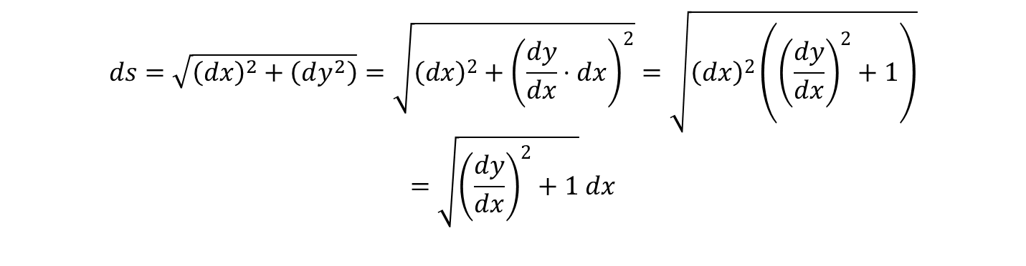

Finding a formula to determine descent time
Considering an infinitesimally small segment of a curve, we can find the length of such a segment:
This length is a variable in the equation used to calculate time:
$$time=\frac{distance}{velocity}=\frac{ds}{v}=\int{\frac{\sqrt{{\left(\frac{dy}{dx}\right)}^{2}+1}}{\sqrt{2g(h−y(x)} }}dx$$
$$ds=\sqrt{{\left(dx\right)}^{2}+\left(dy^{2}\right)}=\sqrt{{\left(dx\right)}^{2}+{\left(\frac{dy}{dx}⋅dx\right)}^{2}}=\sqrt{{\left(dx\right)}^{2}\left({\left(\frac{dy}{dx}\right)}^{2}+1\right)}=\sqrt{{\left(\frac{dy}{dx}\right)}^{2}+1} dx$$
$$Δy=dy$$
$$Δx=dx$$

Slide 7
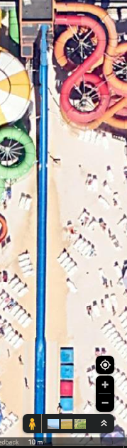
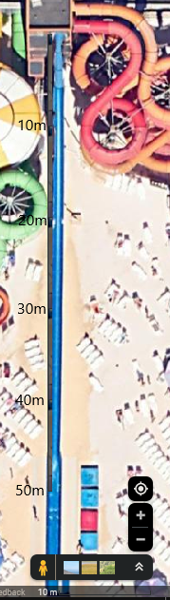
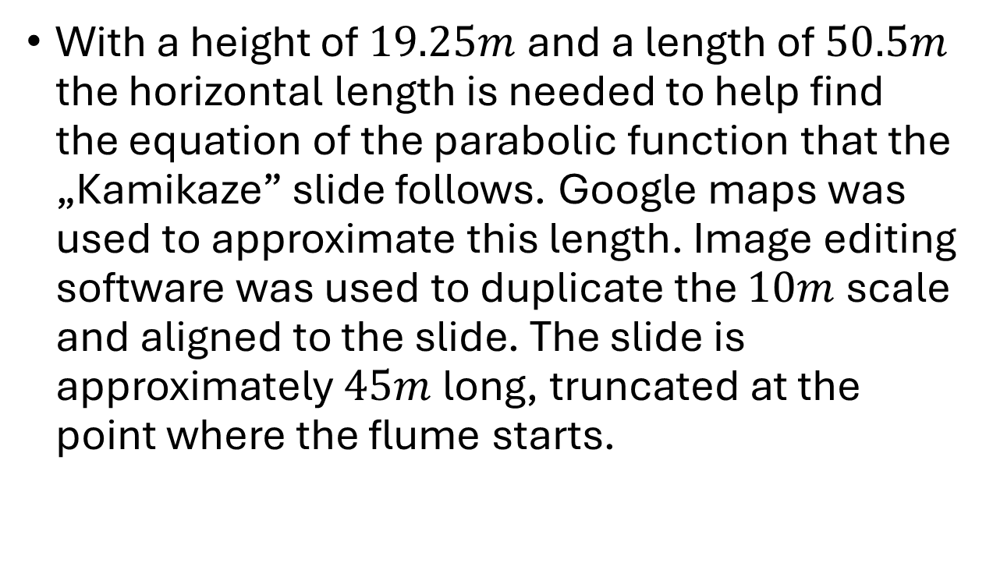
Modelling the waterslide
With a height of $19.25m$ and a length of $50.5m$ the horizontal length is needed to help find the equation of the parabolic function that the „Kamikaze” slide follows. Google maps was used to approximate this length. Image editing software was used to duplicate the $10m$ scale and aligned to the slide. The slide is approximately $45m$ long, truncated at the point where the flume starts.

Slide 8
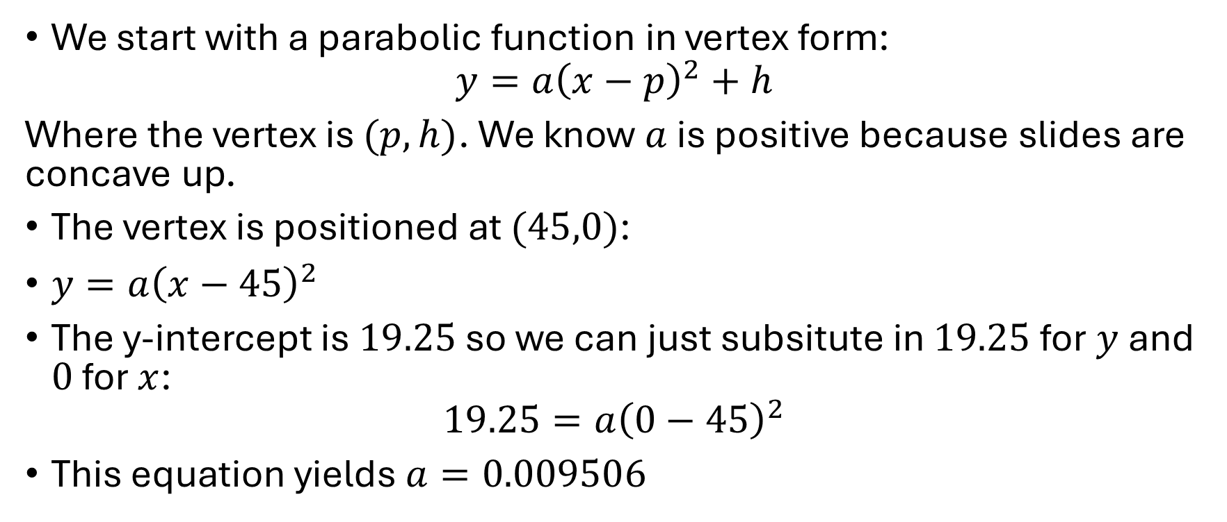
Modelling the waterslide
We start with a parabolic function in vertex form:
$$y={a\left(x−p\right)}^{2}+h$$
Where the vertex is $(p,h)$. We know $a$ is positive because slides are concave up.
The vertex is positioned at $(45,0)$:
$y=a{\left(x−45\right)}^{2}$
The y-intercept is $19.25$ so we can just subsitute in $19.25$ for $y$ and $0$ for $x$:
$$19.25=a{\left(0−45\right)}^{2}$$
This equation yields $a=0.009506$

Slide 9
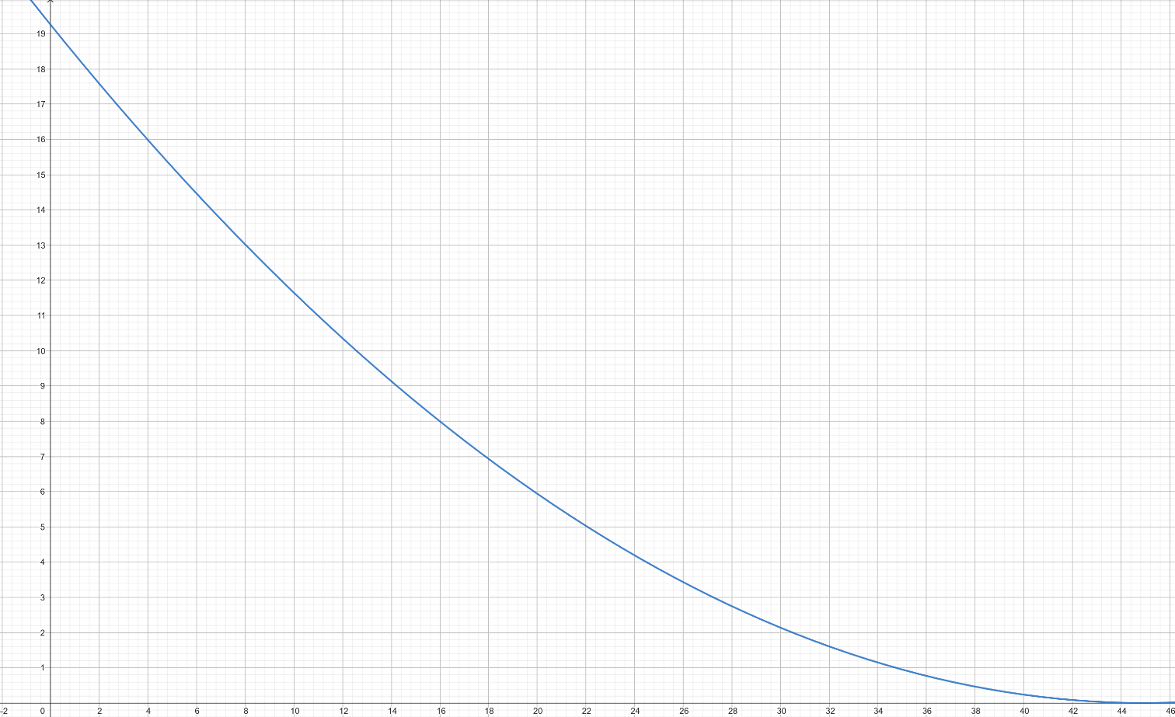

Waterslide function
We now have our function that describes the shape of the waterslide: $y=0.009506{\left(x−45\right)}^{2}$

Slide 10
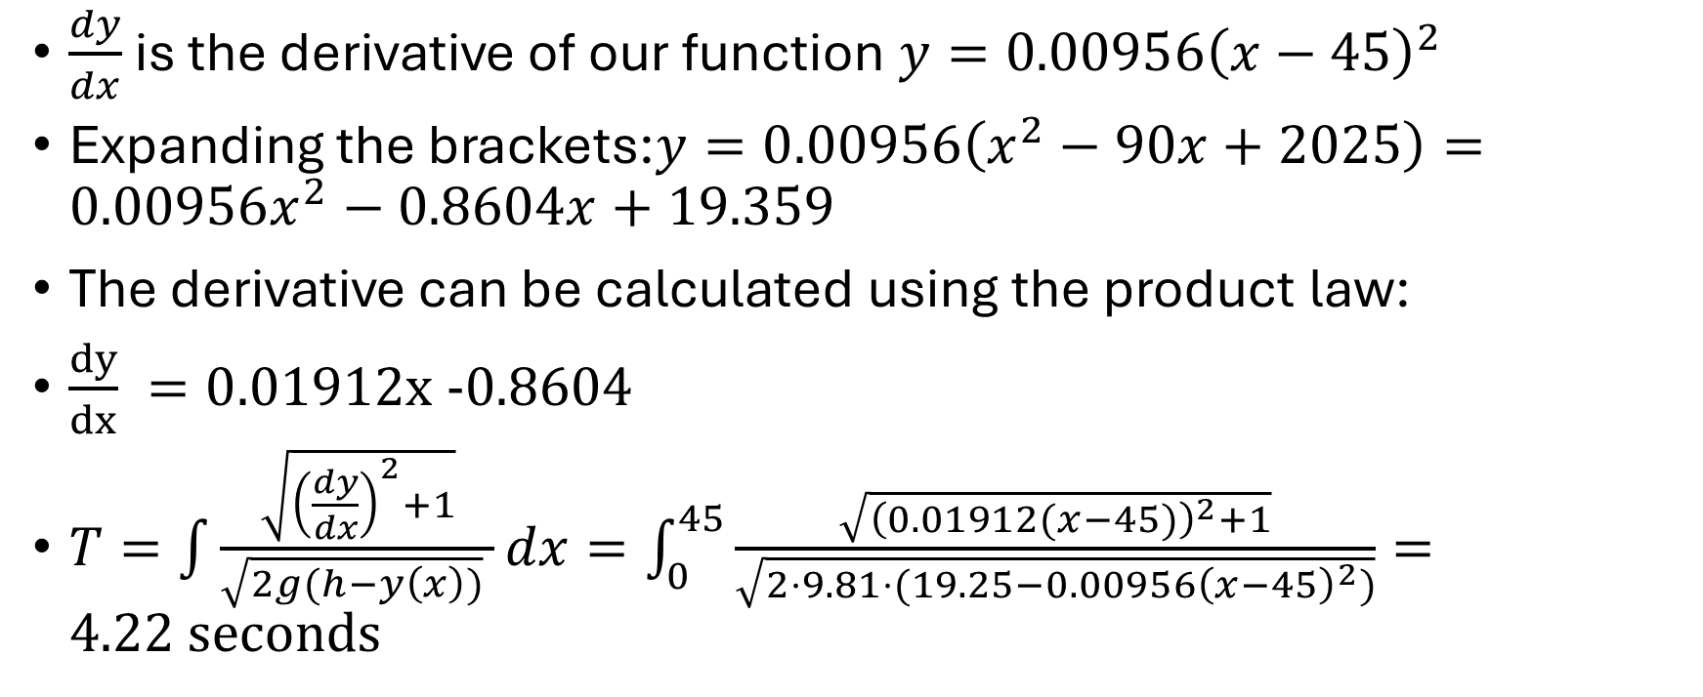
Calculation and Substitution
$\frac{dy}{dx}$ is the derivative of our function $y=0.00956{\left(x−45\right)}^{2}$
Expanding the brackets:$y=0.00956\left(x^{2}−90x+2025\right)=0.00956x^{2}−0.8604x+19.359$
The derivative can be calculated using the product law:
$\frac{dy}{dx} =0.01912x −0.8604$
$T=\int{\frac{\sqrt{{\left(\frac{dy}{dx}\right)}^{2}+1}}{\sqrt{2g(h−y\left(x\right))} }dx}=\int_{0}^{45}{\frac{\sqrt{{\left(0.01912(x−45)\right)}^{2}+1}}{\sqrt{2⋅9.81⋅(19.25−0.00956{\left(x−45\right)}^{2})}}}=4.22 seconds$

Slide 11
Python Code used to calculate integral:
import numpy as np
from scipy.integrate import quad
g = 9.81
h = 19.25
a = 0.009506
def integrand(x):
dy_dx = 0.019012 * (x - 45)
y = a * (x - 45)**2
numerator = np.sqrt(1 + dy_dx**2)
denominator = np.sqrt(2 * g * (h - y))
return numerator / denominator
T, error = quad(integrand, 0, 45)
print(f"Descent time: {T:.2f} seconds")

Slide 12
Conclusion
The descent time for the parabolic waterslide is 4.22 calculated by integrating the time differential along its curved path. This fits between 4 and 5 seconds as stated in the slide’s real-life stats and validates the hypothesis. However, fluid dynamics has not been taken into account. Riders gain velocity from the water and begin with an initial speed. Air resistance, the weight of the rider and the buoyancy force (if any) also have not been taken into account. These shortcomings have led to a shorter descent time being calculated.

